Slide 1
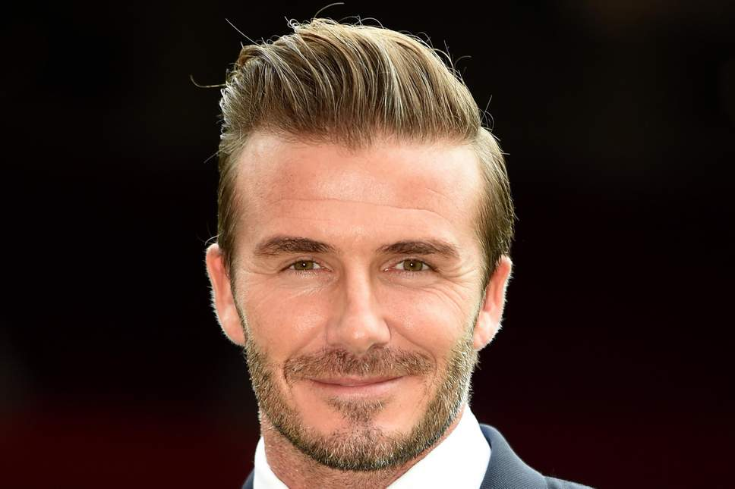
DAVID BECKHAM

Slide 2
Early life
David beckham played for Manchester united preston north end real madrid milan la galaxy paris saint germain(PSG) English national team

Slide 3
His retirement
Retirement. On May 16, 2013 — just days after winning a title with French club Paris Saint-Germain — the 38-year-old Beckham announced that he would be retiring at the end of the 2013 season, ending his 21-year soccer career.2 Apr 2014

Slide 4
His family
Victoria and David Beckham have four children: sons Brooklyn Joseph Beckham (born 4 March 1999 at Portland Hospital, London), Romeo James Beckham (born 1 September 2002 at Portland Hospital, London), Cruz David Beckham (born 20 February 2005 at Ruber International Hospital, Madrid); and daughter Harper Seven Beckham

Slide 5
Thank you

